Slide 1
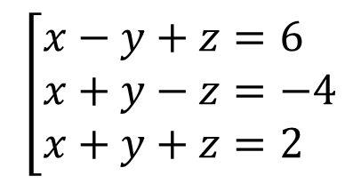
Resuelva el siguiente sistema de ecuación aplicando la regla de cramer
$$\left[\begin{aligned}&x−y+z=6 \\ &x+y−z=−4 \\ &x+y+z=2\end{aligned}\right.$$

Slide 2



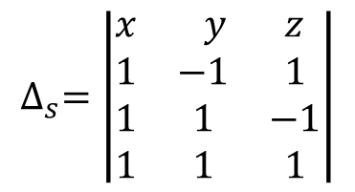
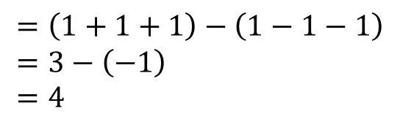


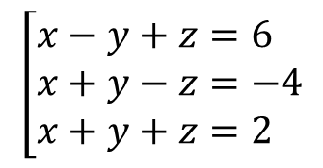

Resuelva el siguiente sistema de ecuación aplicando la regla de cramer
$$\left[\begin{aligned}&x−y+z=6 \\ &x+y−z=−4 \\ &x+y+z=2\end{aligned}\right.$$
$$∆_{s}=4$$
Regla de Sarrus
$$∆_{s}=\left|\begin{aligned}&\begin{matrix}x & y & z\end{matrix} \\ &\begin{matrix}1 & −1 & 1 \\ 1 & 1 & −1 \\ 1 & 1 & 1\end{matrix}\end{aligned}\right|$$
$$∆_{s}=\left|\begin{aligned}&\begin{matrix}x & y & z \\ 1 & −1 & 1 \\ 1 & 1 & −1\end{matrix} \\ &\begin{matrix}1 & 1 & 1 \\ 1 & −1 & 1 \\ 1 & 1 & −1\end{matrix}\end{aligned}\right|$$
$$=\left(1+1+1\right)−\left(1−1−1\right) \\ =3−\left(−1\right) \\ =4$$
Operación diagonal principal
Operación diagonal secundaria
$$∆_{s}=\left|\begin{aligned}&\begin{matrix}x & y & z \\ 1 & −1 & 1 \\ 1 & 1 & −1\end{matrix} \\ &\begin{matrix}1 & 1 & 1 \\ 1 & −1 & 1 \\ 1 & 1 & −1\end{matrix}\end{aligned}\right|$$
$$∆_{s}=\left|\begin{aligned}&\begin{matrix}x & y & z \\ 1 & −1 & 1 \\ 1 & 1 & −1\end{matrix} \\ &\begin{matrix}1 & 1 & 1 \\ 1 & −1 & 1 \\ 1 & 1 & −1\end{matrix}\end{aligned}\right|$$
$$=\left(1+1+1\right)$$
$$=\left(1−1−1\right)$$

Slide 3
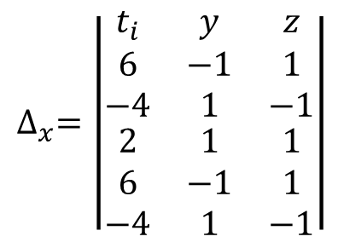
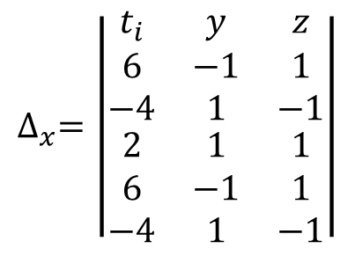

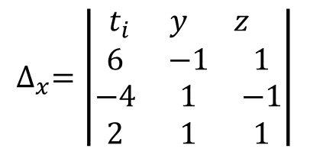
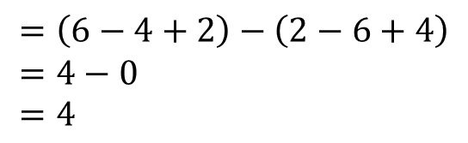

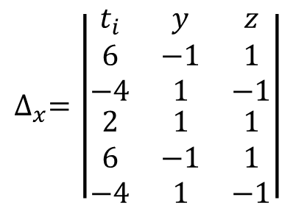

Resuelva el siguiente sistema de ecuación aplicando la regla de cramer
$$\left[\begin{aligned}&x−y+z=6 \\ &x+y−z=−4 \\ &x+y+z=2\end{aligned}\right.$$
$$∆_{s}=4$$
$$∆_{x}=4$$
Regla de Sarrus
$$∆_{x}=\left|\begin{aligned}&\begin{matrix}{ t}_{i} & y & z\end{matrix} \\ &\begin{matrix}6 & −1 & 1 \\ −4 & 1 & −1 \\ 2 & 1 & 1\end{matrix}\end{aligned}\right|$$
$$∆_{x}=\left|\begin{aligned}&\begin{matrix}t_{i} & y & z \\ 6 & −1 & 1 \\ −4 & 1 & −1\end{matrix} \\ &\begin{matrix}2 & 1 & 1 \\ 6 & −1 & 1 \\ −4 & 1 & −1\end{matrix}\end{aligned}\right|$$
$$=\left(6−4+2\right)−\left(2−6+4\right) \\ =4−0 \\ =4$$
Operación diagonal principal
Operación diagonal secundaria
$$∆_{x}=\left|\begin{aligned}&\begin{matrix}t_{i} & y & z \\ 6 & −1 & 1 \\ −4 & 1 & −1\end{matrix} \\ &\begin{matrix}2 & 1 & 1 \\ 6 & −1 & 1 \\ −4 & 1 & −1\end{matrix}\end{aligned}\right|$$
$$∆_{x}=\left|\begin{aligned}&\begin{matrix}t_{i} & y & z \\ 6 & −1 & 1 \\ −4 & 1 & −1\end{matrix} \\ &\begin{matrix}2 & 1 & 1 \\ 6 & −1 & 1 \\ −4 & 1 & −1\end{matrix}\end{aligned}\right|$$
$$=\left(6−4+2\right)$$
$$=\left(2−6+4\right)$$

Slide 4
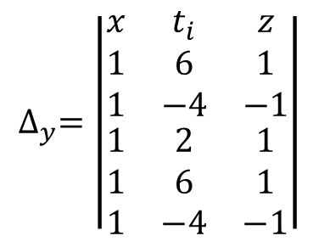
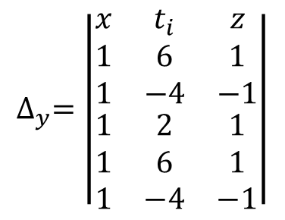


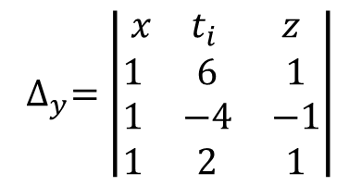
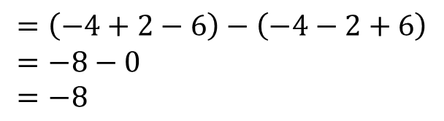
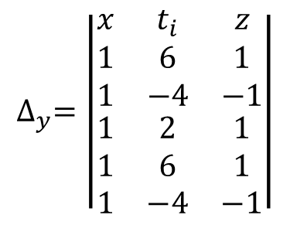

Resuelva el siguiente sistema de ecuación aplicando la regla de cramer
$$\left[\begin{aligned}&x−y+z=6 \\ &x+y−z=−4 \\ &x+y+z=2\end{aligned}\right.$$
$$∆_{s}=4$$
$$∆_{x}=4$$
$$∆_{y}=−8$$
Regla de Sarrus
$$∆_{y}=\left|\begin{aligned}& \begin{matrix}x & t_{i} & z\end{matrix} \\ &\begin{matrix}1 & 6 & 1 \\ 1 & −4 & −1 \\ 1 & 2 & 1\end{matrix}\end{aligned}\right|$$
$$∆_{y}=\left|\begin{aligned}&\begin{matrix}x & t_{i} & z \\ 1 & 6 & 1 \\ 1 & −4 & −1\end{matrix} \\ &\begin{matrix}1 & 2 & 1 \\ 1 & 6 & 1 \\ 1 & −4 & −1\end{matrix}\end{aligned}\right|$$
$$=\left(−4+2−6\right)−\left(−4−2+6\right) \\ =−8−0 \\ =−8$$
Operación diagonal principal
Operación diagonal secundaria
$$∆_{y}=\left|\begin{aligned}&\begin{matrix}x & t_{i} & z \\ 1 & 6 & 1 \\ 1 & −4 & −1\end{matrix} \\ &\begin{matrix}1 & 2 & 1 \\ 1 & 6 & 1 \\ 1 & −4 & −1\end{matrix}\end{aligned}\right|$$
$$∆_{y}=\left|\begin{aligned}&\begin{matrix}x & t_{i} & z \\ 1 & 6 & 1 \\ 1 & −4 & −1\end{matrix} \\ &\begin{matrix}1 & 2 & 1 \\ 1 & 6 & 1 \\ 1 & −4 & −1\end{matrix}\end{aligned}\right|$$
$$=\left(−4+2−6\right)$$
$$=\left(−4−2+6\right)$$

Slide 5
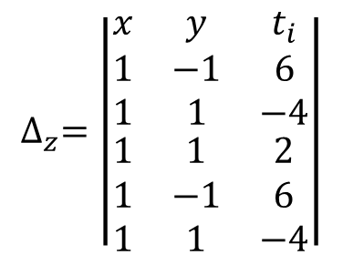

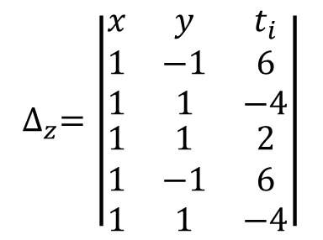

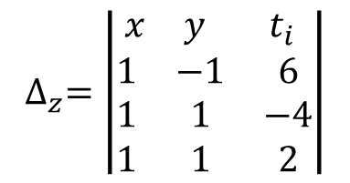
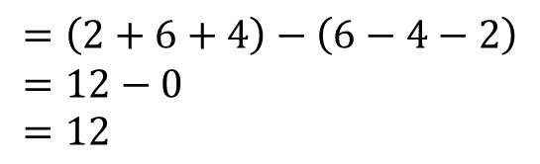
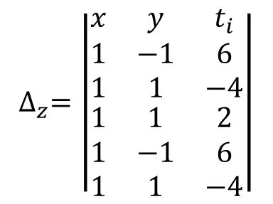

Resuelva el siguiente sistema de ecuación aplicando la regla de cramer
$$\left[\begin{aligned}&x−y+z=6 \\ &x+y−z=−4 \\ &x+y+z=2\end{aligned}\right.$$
$$∆_{s}=4$$
$$∆_{x}=4$$
$$∆_{y}=−8$$
$$∆_{z}=12$$
Regla de Sarrus
$$∆_{z}=\left|\begin{aligned}& \begin{matrix}x & y & t_{i}\end{matrix} \\ &\begin{matrix}1 & −1 & 6 \\ 1 & 1 & −4 \\ 1 & 1 & 2\end{matrix}\end{aligned}\right|$$
$$∆_{z}=\left|\begin{aligned}&\begin{matrix}x & y & t_{i} \\ 1 & −1 & 6 \\ 1 & 1 & −4\end{matrix} \\ &\begin{matrix}1 & 1 & 2 \\ 1 & −1 & 6 \\ 1 & 1 & −4\end{matrix}\end{aligned}\right|$$
$$=\left(2+6+4\right)−\left(6−4−2\right) \\ =12−0 \\ =12$$
Operación diagonal principal
Operación diagonal secundaria
$$∆_{z}=\left|\begin{aligned}&\begin{matrix}x & y & t_{i} \\ 1 & −1 & 6 \\ 1 & 1 & −4\end{matrix} \\ &\begin{matrix}1 & 1 & 2 \\ 1 & −1 & 6 \\ 1 & 1 & −4\end{matrix}\end{aligned}\right|$$
$$∆_{z}=\left|\begin{aligned}&\begin{matrix}x & y & t_{i} \\ 1 & −1 & 6 \\ 1 & 1 & −4\end{matrix} \\ &\begin{matrix}1 & 1 & 2 \\ 1 & −1 & 6 \\ 1 & 1 & −4\end{matrix}\end{aligned}\right|$$
$$=\left(2+6+4\right)$$
$$=\left(6−4−2\right)$$

Slide 6
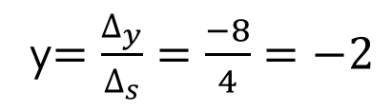
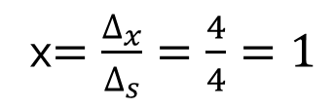
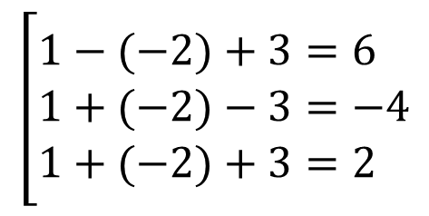
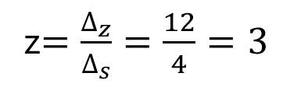
Resuelva el siguiente sistema de ecuación aplicando la regla de cramer
$$\left[\begin{aligned}&x−y+z=6 \\ &x+y−z=−4 \\ &x+y+z=2\end{aligned}\right.$$
$$∆_{s}=4$$
$$∆_{x}=4$$
$$∆_{y}=−8$$
$$∆_{z}=12$$
x$=\frac{∆_{x}}{∆_{s}}=\frac{4}{4}=1$
y$=\frac{∆_{y}}{∆_{s}}=\frac{−8}{4}=−2$
z$=\frac{∆_{z}}{∆_{s}}=\frac{12}{4}=3$
Prueba sustituyendo.
$$\left[\begin{aligned}&1−(−2)+3=6 \\ &1+(−2)−3=−4 \\ &1+(−2)+3=2\end{aligned}\right.$$

